Slide 1
Local Matters: Washington November 3, 2015 Demographic and Socio-Economic Profile of Washington’s Population
Marc Baldwin, Ph.D.
Office of Financial Management
Forecasting and Research Division

Slide 2
Overview of Presentation
Some Big Economic Trends
Economic Change
Population Change (Counts, Geography)
Demographic Change

Slide 3
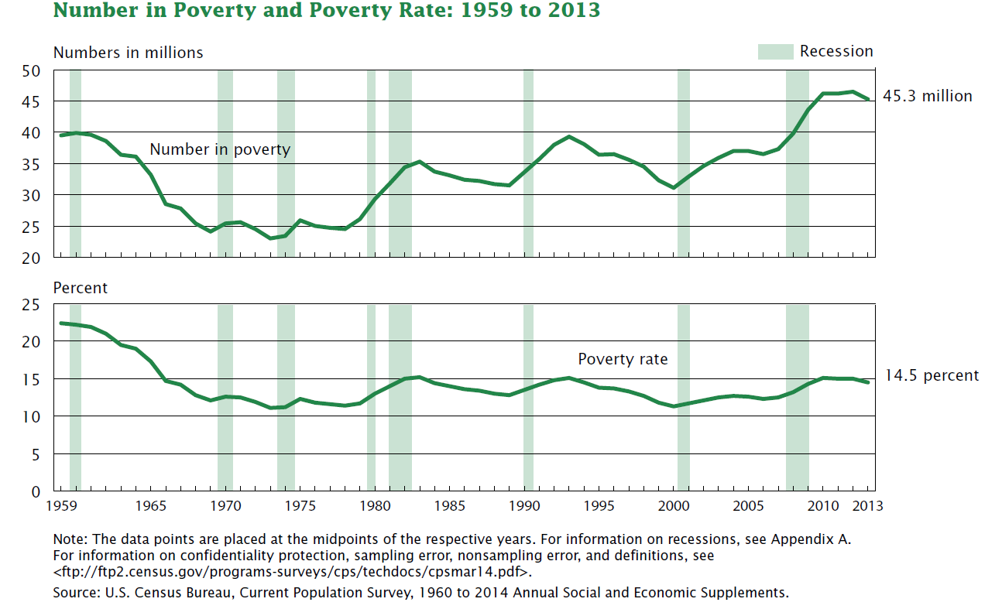
Moving Beyond Poverty? Not lately…

Slide 4
Historically Slow Recovery

Slide 5
Low Unemployment Rates Hasn’t Automatically Resulted in Wage Gains
Wages moved slightly as
unemployment fell.
Source: Bureau of Labor Statistics

Slide 6
Many “prime age” workers are leaving the labor force all together in the recovery.
Source: Bureau of Labor Statistics

Slide 7
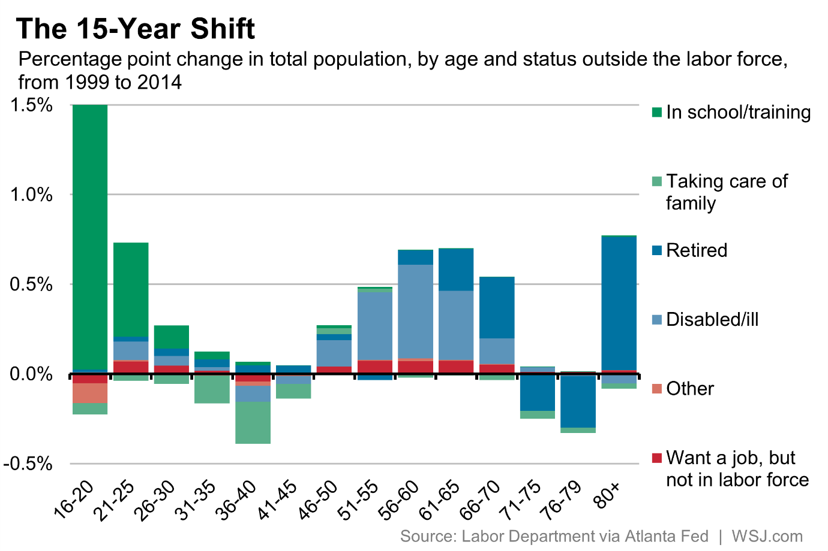

Slide 8
Several sectors in Washington still have not fully recovered.
Source: Washington State Employment Security Department

Slide 10
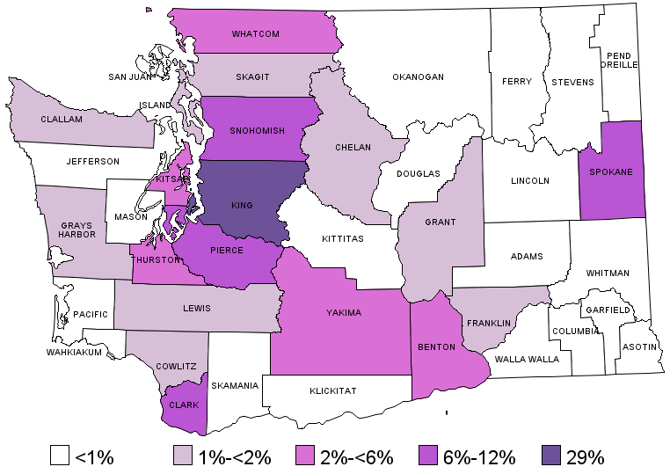
Where is Population Located?
Notes:
Updated with 2015 data

Slide 11
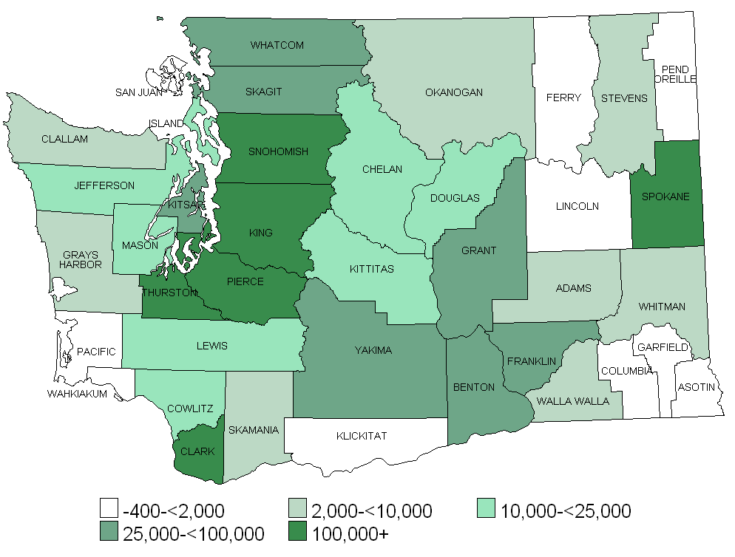
Projected Growth 2010-2040 In absolute numbers

Slide 12
Race/Ethnicity
Washington’s population is changing
People of Color and Hispanic Population
2000 20.6% or 1,214,291 people
2010 27.3% or 1,835,752 people
2014 29.2% or 2,035,530 people

Slide 13
Change in Non-Hispanic Racial Composition: 2000-2010
 | Number
 | 2000 | 2010 | 2010-2000 | % Growth
White Alone | 4,679,852 | 4,888,788 | 208,936 | 4.5%
Black or African American Alone | 189,277 | 231,472 | 42,195 | 22.3%
American Indian/Alaska Native Alone | 86,359 | 89,149 | 2,790 | 3.2%
Asian Alone/Native Hawaiian and Other Pacific Islander Alone | 348,821 | 519,073 | 170,252 | 48.8%
Two or More Races | 148,325 | 240,268 | 91,943 | 62.0%
Total | 5,452,634 | 5,968,750 | 516,116 | 9.5%

Slide 14
Change in Non-Hispanic Racial Composition: 2010-2014
 | Number
 | 2010 | 2014 | 2010-2014 | % Growth
White Alone | 5,535,262 | 5,656,119 | 120,857 | 2.2%
Black or African American Alone | 252,333 | 270,420 | 18,087 | 7.2%
American Indian/Alaska Native Alone | 122,649 | 127,578 | 4,929 | 4.0%
Asian Alone | 491,685 | 538,828 | 47,143 | 9.6%
Native Hawaiian and Other Pacific Islander Alone | 43,505 | 48,369 | 4,864 | 11.2%
Two or More Races | 279,106 | 326,856 | 47,750 | 17.1%
Total | 6,724,540 | 6,968,170 | 243,630 | 3.6%
Notes:
Source: Small Area Demographic Estimates (SADE)

Slide 15
Hispanic Growth

Slide 16
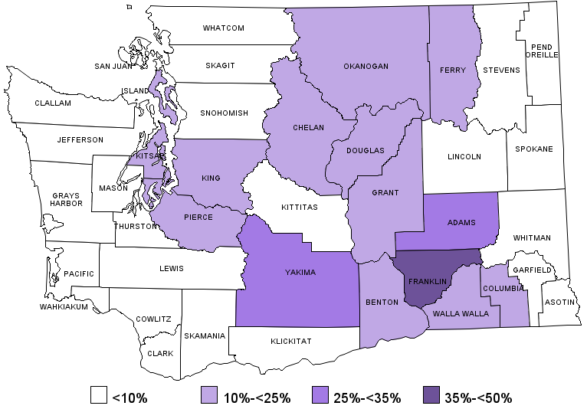
Percent Minority in 1990
Notes:
Using SADE data 1977 race codes

Slide 17
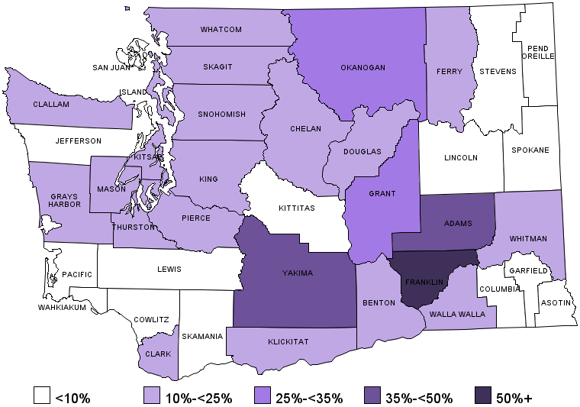
Percent Minority in 2000
Notes:
Using SADE data 1977 race codes

Slide 18
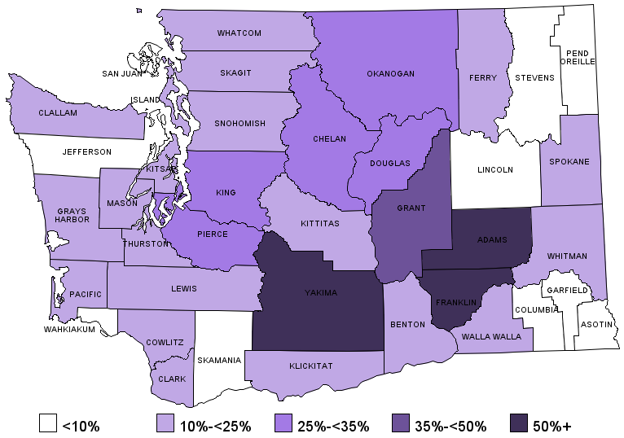
Percent Minority in 2010
Notes:
Using SADE data

Slide 19
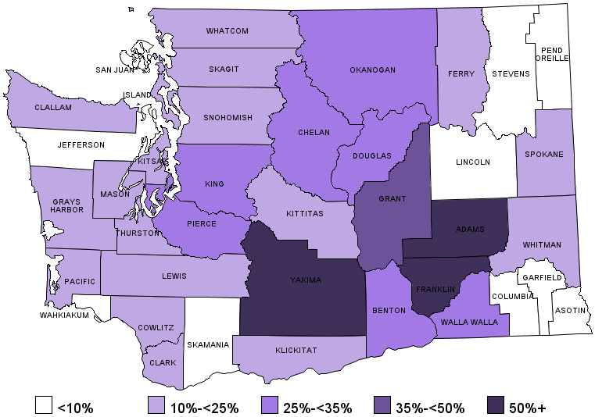
Percent Minority in 2014
Notes:
Using SADE data 1977 race codes
Benton and Walla Walla shift categories

Slide 20
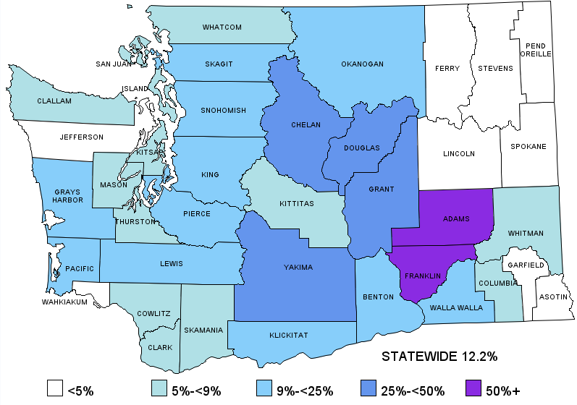
Percent Hispanic in 2014 by County
Notes:
Updated with 2014 data

Slide 21
Median Age by Race/Ethnicity
Notes:
Updated using ACS 2014 data (this isn’t currently available via OFM data)

Slide 22
The 65 and Over Population Will Double in 20 Years
Growth in the Elderly
Population by Age Group
Decade Growth Trends:
Total Population and Age 65+
420,000
426,400
Notes:
This chart shows the actual magnitude of aging population. The number of 65 and over Washingtonians are expected to increase from 828,000 in 2010 to over 1.67 million in 2030. This means in the next 20 years the state senior population will increase 5% every year, about 42,500.

Slide 23
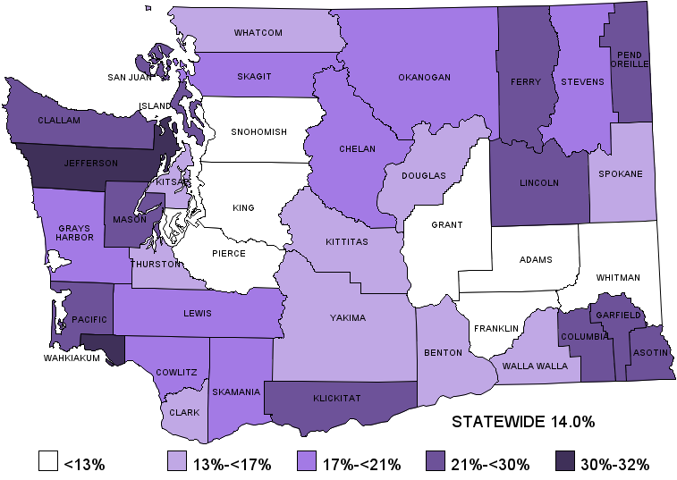
Percent Aged 65+ in 2014

Slide 24
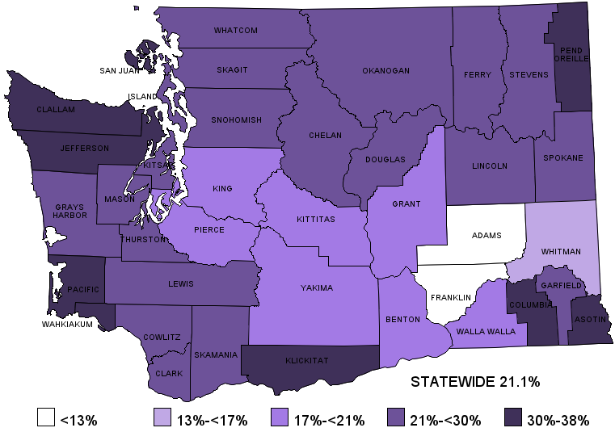
Percent Aged 65+ in 2040
Notes:
Uses same scale as prior slide. The highest percentage 65+ is 38% up from 32% in 2014 (Wahkiakum).

Slide 25
Statewide Ratio of Working Age (19-64) To Non-Working Age Declines as Boomers Get Older
Source: Office of Financial Management
Notes:
Updated with 2014 state forecast data.

Slide 26
An Aging Population Means More People to Support with Fewer People to Support Them
Year | Child Dependency Ratio (0-17) | Aged Dependency Ratio (65+) | Total Dependency Ratio |  | Total Dependents (Millions) | Percent of Population of Working Age (18-64)
1970 | 60:100 | 17:100 | 77:100 |  | 1.5 | 56.6%
1980 | 44:100 | 17:100 | 61:100 |  | 1.6 | 62.0%
1990 | 42:100 | 19:100 | 61:100 |  | 1.8 | 62.2%
2000 | 41:100 | 18:100 | 59:100 |  | 2.2 | 63.1%
2010 | 37:100 | 19:100 | 56:100 |  | 2.4 | 64.2%
2020 | 37:100 | 28:100 | 65:100 |  | 2.9 | 60.7%
2030 | 39:100 | 36:100 | 74:100 |  | 3.5 | 57.3%
2040 | 39:100 | 37:100 | 76:100 |  | 3.8 | 56.9%
Dependency ratio measures how many dependent persons (aged 0-17 and 65 and over) per one hundred working age people (aged 18-64)
Notes:
What does it mean when the elderly population increases by 5% each year and the total population only grows about 1%? We use an age dependency ratio to illustrate the impact. Dependency ratio measures how many dependent persons (aged 0-17 and 65 and over) per one hundred working age people (aged 18-64). The general message in this table is that increasingly aging population means more people need support and less people to support them in the next 10 to 20 years.
As you can see in col. 3 that in year 2010 before the first boomers turned 65, we have a total dependency ratio of 56 per100 working age people, and col. 2, indicates only 19 are elderly. Then if we look at 2030, that is when all the boomers turn 65, the aged dependent ratio increase from 19 in 2010 to 36 and the total dependency ratio has increased from 56 to 74.
More importantly, if you look at the last col., the percentage of the working age population declines from 64% in 2010 to 57% in 2030.

Slide 27
2014 Median Household Income by Race/Ethnicity of Householder
Race/Ethnicity | 2014 Median Income | % of NH White
White (alone) | $62,357 | 98%
African American/Black (alone) | $43,296 | 68%
American Indian/Alaska Native (alone) | $37,856 | 60%
Asian (alone) | $75,039 | 118%
Native Hawaiian and Other Pacific Islander (alone) | $55,027 | 87%
Some other race (alone) | $45,208 | 71%
Two or more races | $53,999 | 85%
Hispanic | $47,010 | 74%
White alone, not Hispanic or Latino | $63,519 | Reference
Notes:
Updated with 2014 Median Income (using B19013 tables)

Slide 28
Percent Poor by Race/Ethnicity
 | 2014 ACS | % of NH White
White | 11.7% | 10.9%
African American/Black | 24.7% | 135.1%
American Indian/Alaska Native | 30.6% | 191.5%
Asian | 12.0% | 14.7%
Native Hawaiian and Other Pacific Islander | 17.3% | 64.6%
Some other race | 23.2% | 121.2%
Two or more races | 18.3% | 73.9%
Hispanic | 23.0% | 118.8%
White alone, not Hispanic or Latino | 10.50% | Reference
Notes:
Updated with 2014 ACS data

Slide 29
Percent Poor and Near Poor by Age and Sex
 | Under 100% FPL | Under 200% FPL
Total | 13.2% | 29.9%
0-17 | 17.5% | 38.6%
18-64 | 12.7% | 27.9%
65+ | 8.4% | 25.0%
Males | 12.2% | 27.8%
Females | 14.1% | 31.4%
Notes:
Updated with 2014 data
Use b17001 and C17024
PUMS data for U200 by sex

Slide 30
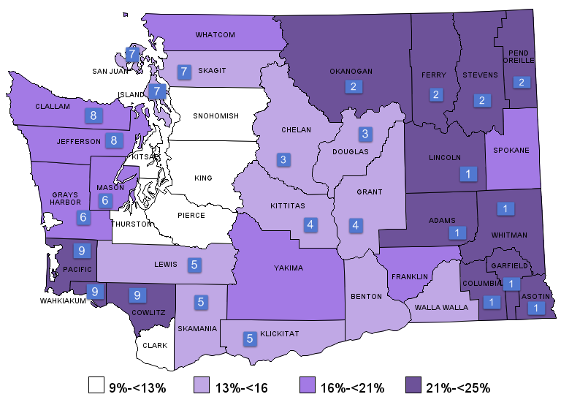
Percent of Population Under 100% FPL
Notes:
Updated with 2014 ACS data
The poverty status for same numbered counties was computed together. (data isn’t released for counties with less than 65,000 so it is necessary to group counties together).
Since Benton and Franklin qualified for a county estimate those are reported. Walla Walla’s estimate is combined with the non-metro portions of Benton and Franklin, but is represented here only as Walla Walla’s estimate.

Slide 31
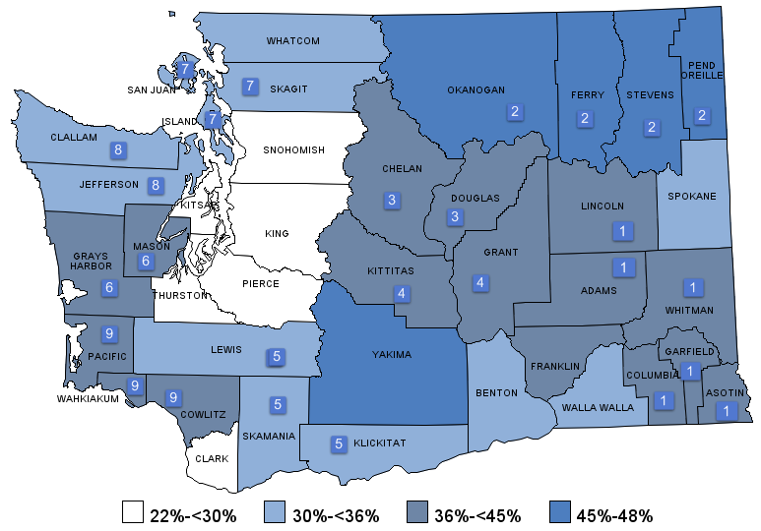
Percent of Population Under 200% FPL
Notes:
Updated with 2014 ACS 1 year data
The poverty status for same numbered counties was computed together. (data isn’t released for counties with less than 65,000 so it is necessary to group counties together).
Since Benton and Franklin qualified for a county estimate those are reported. Walla Walla’s estimate is combined with the non-metro portions of Benton and Franklin, but is represented here only as Walla Walla’s estimate.

