Slide 1
Hyper-Local Matters
Bellingham, Washington 2015

Slide 2
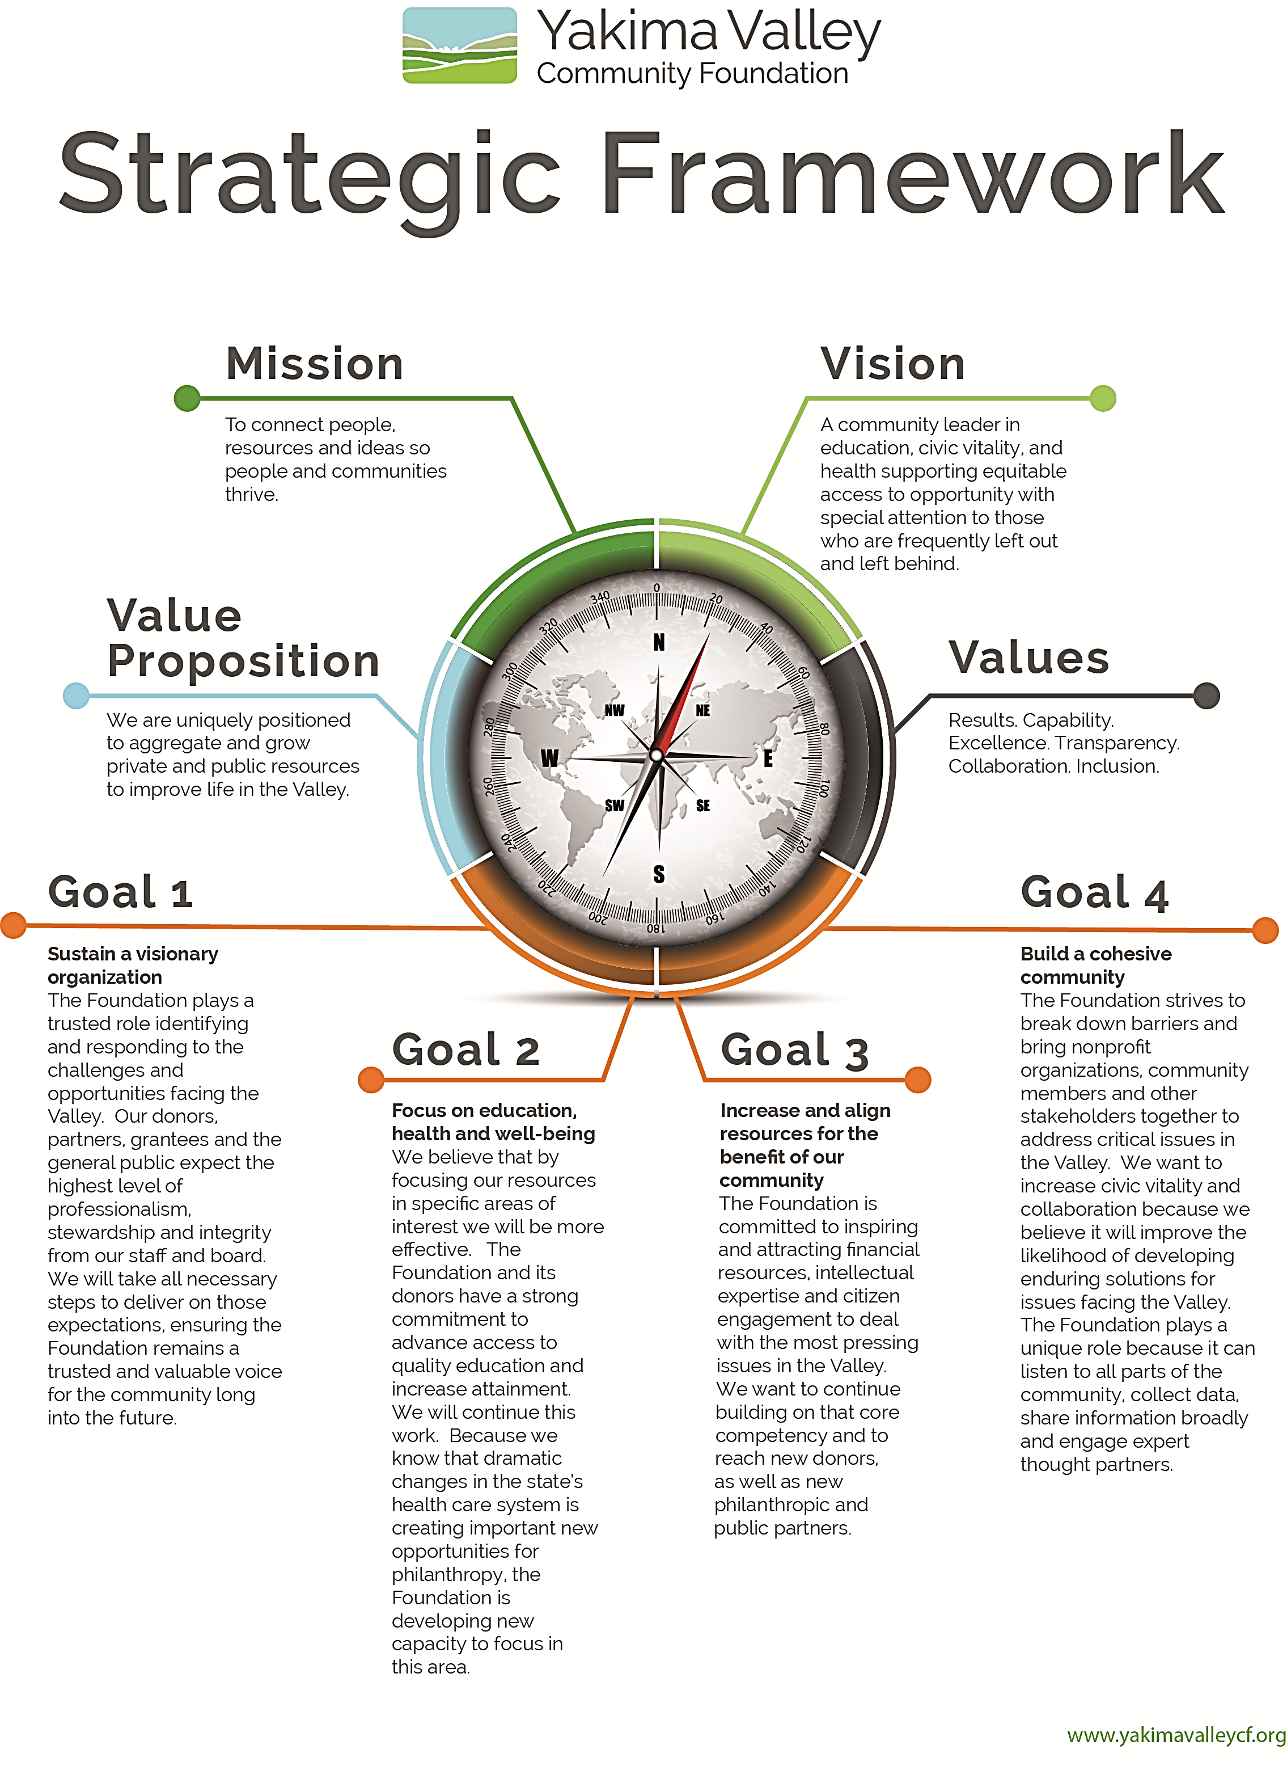

Slide 3
BOD’s Role: Guide Alignment
Vision
Mission
Values
Goals & Implementing Strategies
Business Model

Slide 4
BOD’s Role: Culture of Mutual Accountability
A culture of mutual accountability begins with the Foundation.
CEO with
Strategic Partners
CEO & Board
With Donors
Internal &
External Conversations
Executive
coordinates review of CEO
CEO with STAFF
Director of Grants with Grantees
Governance
Leads Board Self Assessment
All assess work plan
Finance Integrity of Financial Systems

Slide 5
Cross Cutting Strategies
Goal 1
Sustain a visionary organization
Goal 2
Education, Health & Well Being
Goal 3
Increase and align resources
Goal 4
Build a cohesive community
Implement Data Indicators Project. Grow data driven strategy & granting.
Allocate 60% of the Grants Budget to Strategic granting in Education, Health & Well Being and Community Cohesion: 40% to Responsive .
Continue to increase “net” grant: grow technology, reduce time/cost/lower transaction costs
Increase Community Engagement.
Nurture vitality of committee work and board engagement.
Nurture and grow staff.
Nurture and grow philanthropic partners.

Slide 6
Increase and Align Resources
Barring large quick changes in the environment (like ACA and health coverage), most movement on community indicators happens incrementally.
Focus investments on communities where indicators are substantially worse than the county average.
Moving indicators in those communities will move the County average.
Goal 3
Increase and align resources for the benefit of our community
The Foundation is committed to inspiring and attracting financial resources, intellectual expertise and citizen engagement to deal with the most pressing issues in the Valley.
We want to continue building on that core competency and to reach new donors,
as well as new philanthropic and
public partners.

Slide 7
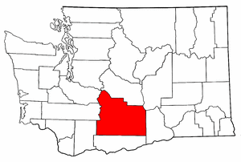
Yakima County

Slide 8
Quick Facts about Yakima County
Agriculture foundation of Yakima County’s economy 100 years
1st in the nation in Hop Production; leading in apples and tree fruit
2nd largest county in the State 2.75 million acres
3 non taxable entities own or control 1.7 million acres 63%:
The Yakama Nation, US Forest Service, US Military Reservation
10th largest city in the state with 35% of the population of 249,970; about 2/3 of the population reside within unincorporated areas of the County

Slide 9
Quick Facts: Yakima County

Slide 10
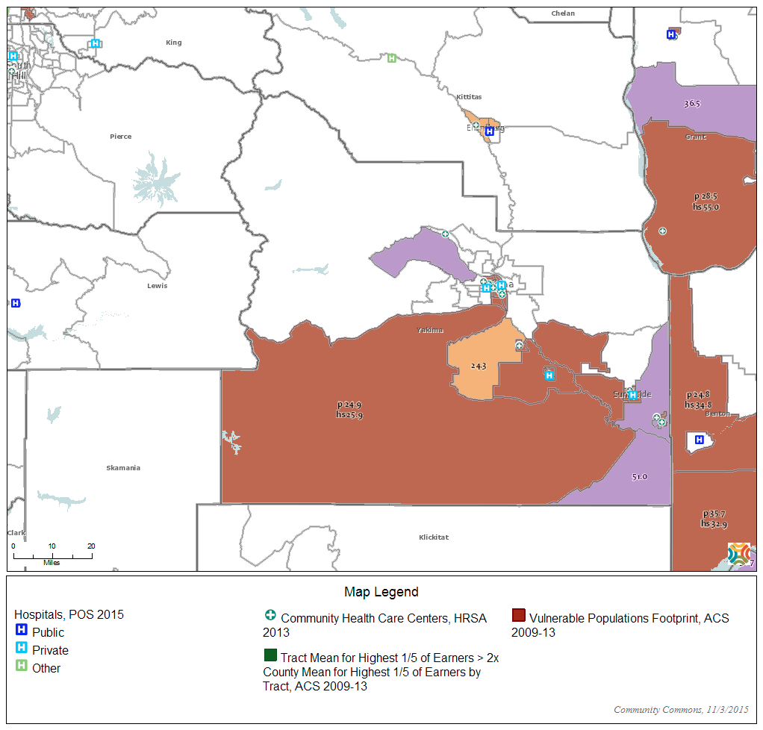
The Adaptive Challenge. Creating Equitable Access to Opportunity
For the last 50 years Yakima County has ranked in the top 3 of the poorest counties in Washington State.

Slide 11
Addressing the forces that Create Poverty
State Tax System - most regressive in the nation.
A family of four earning less than $24,000 a year (close to 25%) pays 7 times the tax of the highest income earners.
Education Funding
With high tax rates, poor districts often can raise only a fraction as much. Bellevue, for example, raises $2,854 per student with a rate of $1.25 per $1,000 of assessed valuation. Yakima, in contrast, raises $900 per student with a rate of $3.13 per $1,000. In other words, Yakima must tax at more than twice the rate of Bellevue to get a quarter of the money.
Utilities produced by crumbling infrastructure largest source of small town revenue

Slide 12
Financing Tools to Braid Resources
Existing Funding mechanisms:
Are insufficient in design and amount to address the root causes of poverty creation.
Under-invest in prevention, leading to greater expenditures in remediation.
Are jurisdictionally siloed.
Are not tied to outcomes or data driven.
Typically fund a set quantity of services
Are geared to urban areas making them too expensive and too complex to apply on this scale

Slide 13
What will the funding mechanism(s) fund?
Leverage parental engagement & community culture School Sports, Parks and Recreation with trauma informed staffing.
Replace/Repair crumbling infrastructure as identified in existing Capital Facilities plans

Slide 14
Aggregate and Braid Financial Capital
Realign Existing School Municipal Bond Debt
Access New Market Tax Credits
Social Impact Bond component to realign existing resource allocations
Provide and attract philanthropic equity

Slide 15
Grow Effectiveness of Human Capital – Our Partners
Two sovereign nations, the United States of America and the Yakama Nation;
New Yakima Council on Governments
8 incorporated Cities or towns eight are within the focus area (Grandview, Granger, Harrah, Mabton, Sunnyside, Toppenish, Wapato and Zillah).
Two Port Districts,
Eight School Districts
Commercial Investment Banking and Banks
Philanthropic Equity

Slide 16
Why Invest ?
Yakima is becoming the Silicon Valley of Non Profit Excellence. We work with the people working out of their garage on Innovation in the social sector connecting ideas, people and resources.

Slide 17
New Day In Yakima County

